Slide 1
Drools

Slide 2
Intro to Rules Engines
The input is Data which goes through a domain expert module and a decision is the output
What starts out a “if-then-else” rules can easily become a tree and the code can get complicated
Rule Engine
  When a condition is true then an action is executed
  don’t specify the order
Programming Drools is declarative
  Describe in small step what you want
  don’t specify in an ordered sequence how to achieve this
  SQL is another example of a declarative language – don’t care how the engine gets the data or what data structures that it uses
How to use Drools Rule Engine to decouple complex business decision trees into individual simple to read rules

Slide 3
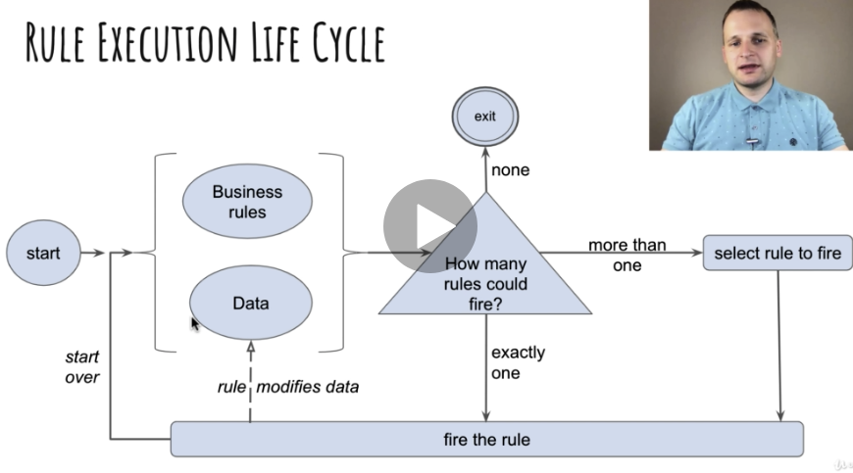
Rule Execution of a LifeCycle

Slide 4
How to Design Rules and When not to use Drools
Rule Independency – A rule should not depend on any other specific rule.
  The rules should depend on data instead
Rule Atomicity – Rules should be designed as simple as possible.
  Complicated rules should be split into several rules until they cannot be divided into anything smaller
Data defines the rules to fire next
  Possible to impact the order of which rules are fired this should remain to special cases only
  The rule changes the data and then other rules can fire
Methods vs rules
  Rules execute by matching against any data inserted into the engine
  Rules can never be called directly
    Create the situation so you have the data
  Specific instances cannot be passed to a rule
  Depending on the matches, rules may fire once or several times or not at all

Slide 5
How to Design Rules and When not to use Drools
When to use rules
  If it difficult for any one person to fully understand without digging in
    each business rules defines a small component of a complex scenario
  Requirements keep changing over time
    easier to make changes because no need to analyze the whole tree
    more people can work on the rules at the same time
  Decision has to be made quickly
Don’t use Drools if
  you don’t have many rules
  rules don’t change often
  you need tight control over execution flow

Slide 6
Introduction to Drools Language Syntax
Example
  rule <name> // The name must be unique
  attributes
  when
    Left hand side → Written in MVEL or Java
  then
    Right Hand Side → Written in Hjava
  end
Example
import io.github.aasaru.drools.domain.Passport;
rule “Valid passport”
  dialect “mvel” // The attribute is the dialect mvel is a DSL good for pattern matching
when
  Passport( !isExpired().unusedVisaPages > 0 ) // looking for instances of class Passoword with attributes isExpired(), unusedVisaPages
then
  Sytem.out.println(“This passport is OK”);
end

Slide 7
MVEL BASICS
Equal:
  className( condition1 , condition2, …) Pattern Matching
    , or && and
  Can use OR Constructs
    ClassName(condition1 || condition2 || … )
  Value Correction
    “1234” == 1234 String and Numbers are automatically converted
Conditions in MVEL
  List
    names = [“Sarah”, “Simon”, “Emily”, “James” ]
    names[1] // returns Simon
  Arrays
    { “Sarah”, “Simon”, “Emily”, “Chuck”}
    String are arrays
      Country = “Canada”
      country[0] // returns ‘C’[
  Maps
    person = [“first_name” : “Sarah”, “family_name” : “Murphy” ]
    person[“family_name”] // returns “Murphy:
    person.family_name returns Murphy

Slide 8
MVEL BASICS
Expression in MVEL | Same Expression in Java
passport.passportNumber | passport.getPassportNumber()
person.?company.name | String name = ( person.getCompany() != null ) ? person.getCompany().getName() : null;
passport.passportNumber == ‘12345’ | “12345”.equals(passport.getPassportNumber());
passport.county.in [“US”,”GB”,”CA”] | java.util.Arrays.asList(“US”, “GB”, “CA”).contains(passport.getCountry());
passport == null, passport == nil | passport = null
passport.name = “Simon Murphy” | passport.setName(“Simon Murphy”)

Slide 9
MVEL Basics
Right Hand Side of Drools Rules
  Written in Java
  Can contain some Drools keywords like modify
  Can refer to the objects in when part

Slide 10
Stateless Sessions – First Two Rules to validate
First Rules – Detect Valid Passports
  rule “Valid Passport”
    dialect “mvel”
    when
      Passport( !isExpired(), unusedVisaPages > 0 )
    then
      System.out.println(“This passport is correct”);
  end
rule “Expired or full password”
  dialect “mvel”
  when
    Passport( isExpired() || unusedVisaPages == 0 )
  then
    System.out.println(“This passport is INVALID because it is expired or has not space for VISA”);
  end

Slide 11
Stateless Sessions – First Two Rules to validate
In the META-INF Directory must have a
  <kmodule xmlns=”http://ww.drools.org/xsd/kmodule”>
    <kbase packages=”io.github.asasary.drools.section03.step1”>
      <ksession name=”statelessPassportValidationStep1” type=”stateless”>
    </kbase>
  </kmodule>
Main Code
  Get the data first
  Create the rules Container – Stateless Session kieContainer = kieContainer.newStatelessKieSession(“StatelessValidationStep1”);
  kieSession.execute(passports);

